Slide 1
Design of a Soil Moisture Reading Device
Presented By:
Riya Biswas (ID- 18702001)
Sadia Parvin (ID-18702019)
Khurshida Jahan (ID-18702033)
Department of Electrical And Electronic Engineering
University of Chittagong

Slide 2
Abstract
The aim of the project is to introduce a low cost, simple and effective soil moisture measuring device. In this project we used moisture sensor to measure the volumetric water content of the soil and then it is transferred through Arduino Uno to LCD and LED’s to show the readings accordingly.

Slide 3
Components
The main components used in this project are –
Arduino Uno
Moisture Sensor
LCD
LED

Slide 4
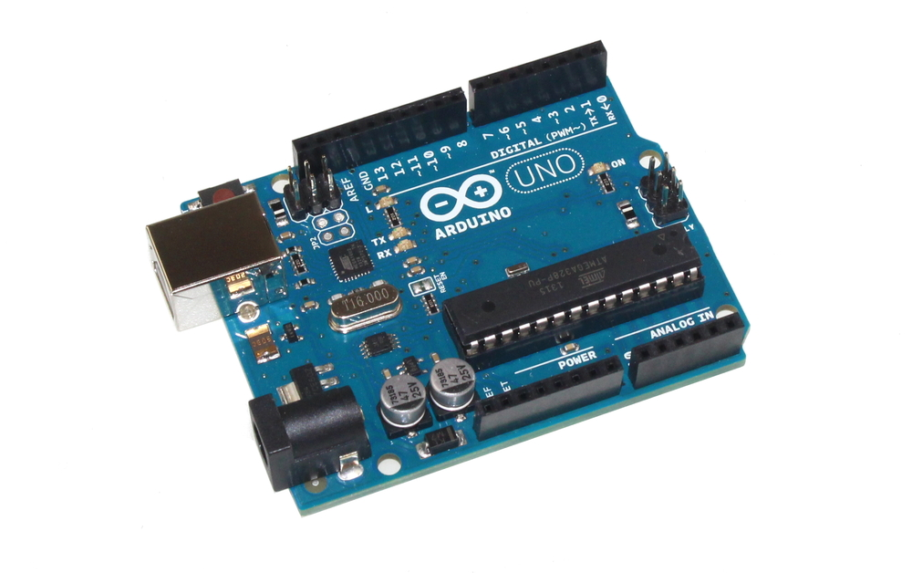
Arduino Uno
The Arduino Uno is a microcontroller board based on the ATmega328. It has 14 digital input/output pins and also has 6 analog input pins.

Slide 5
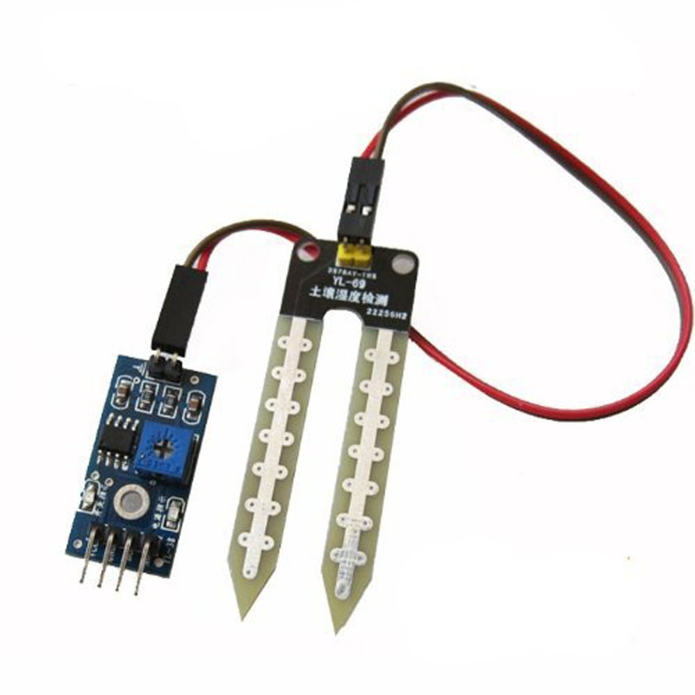
Moisture Sensor
Soil moisture sensors measure the volumetric water content indirectly by using some other property of the soil, such as electrical resistance.

Slide 6
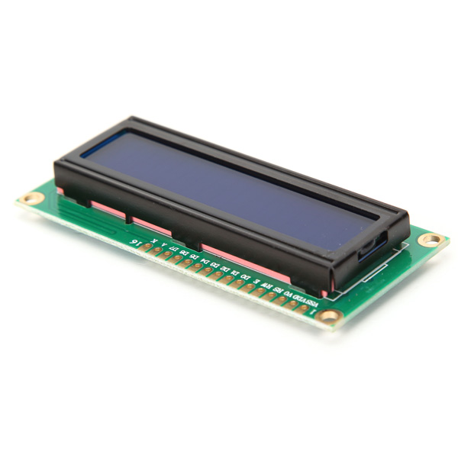
Liquid Crystal Display (LCD)
LCD (Liquid Crystal Display) screen is an electronic display module. A 16x2 LCD display is very basic module and is very commonly used in various devices and circuits.

Slide 7
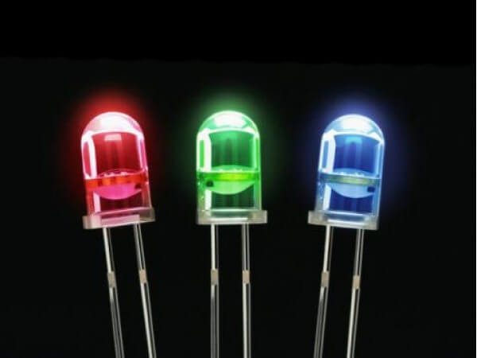
Light-Emitting Diode (LED)
A light-emitting diode (LED) is a two-lead semiconductor light source. It is a p–n junction diode that emits light when activated.

Slide 8
Block Diagram
LCD
Moisture Sensor
Arduino Uno
LED

Slide 9
Application
This device can greatly useful to deal with the situations like
On Agricultural Field.
On the surface where buildings will be constructed.
In sports fields.
In researches related to soil.

Slide 10
Advantages
The design adopted here is simple in structure.
Suitable for everyone.
Low cost.

Slide 11
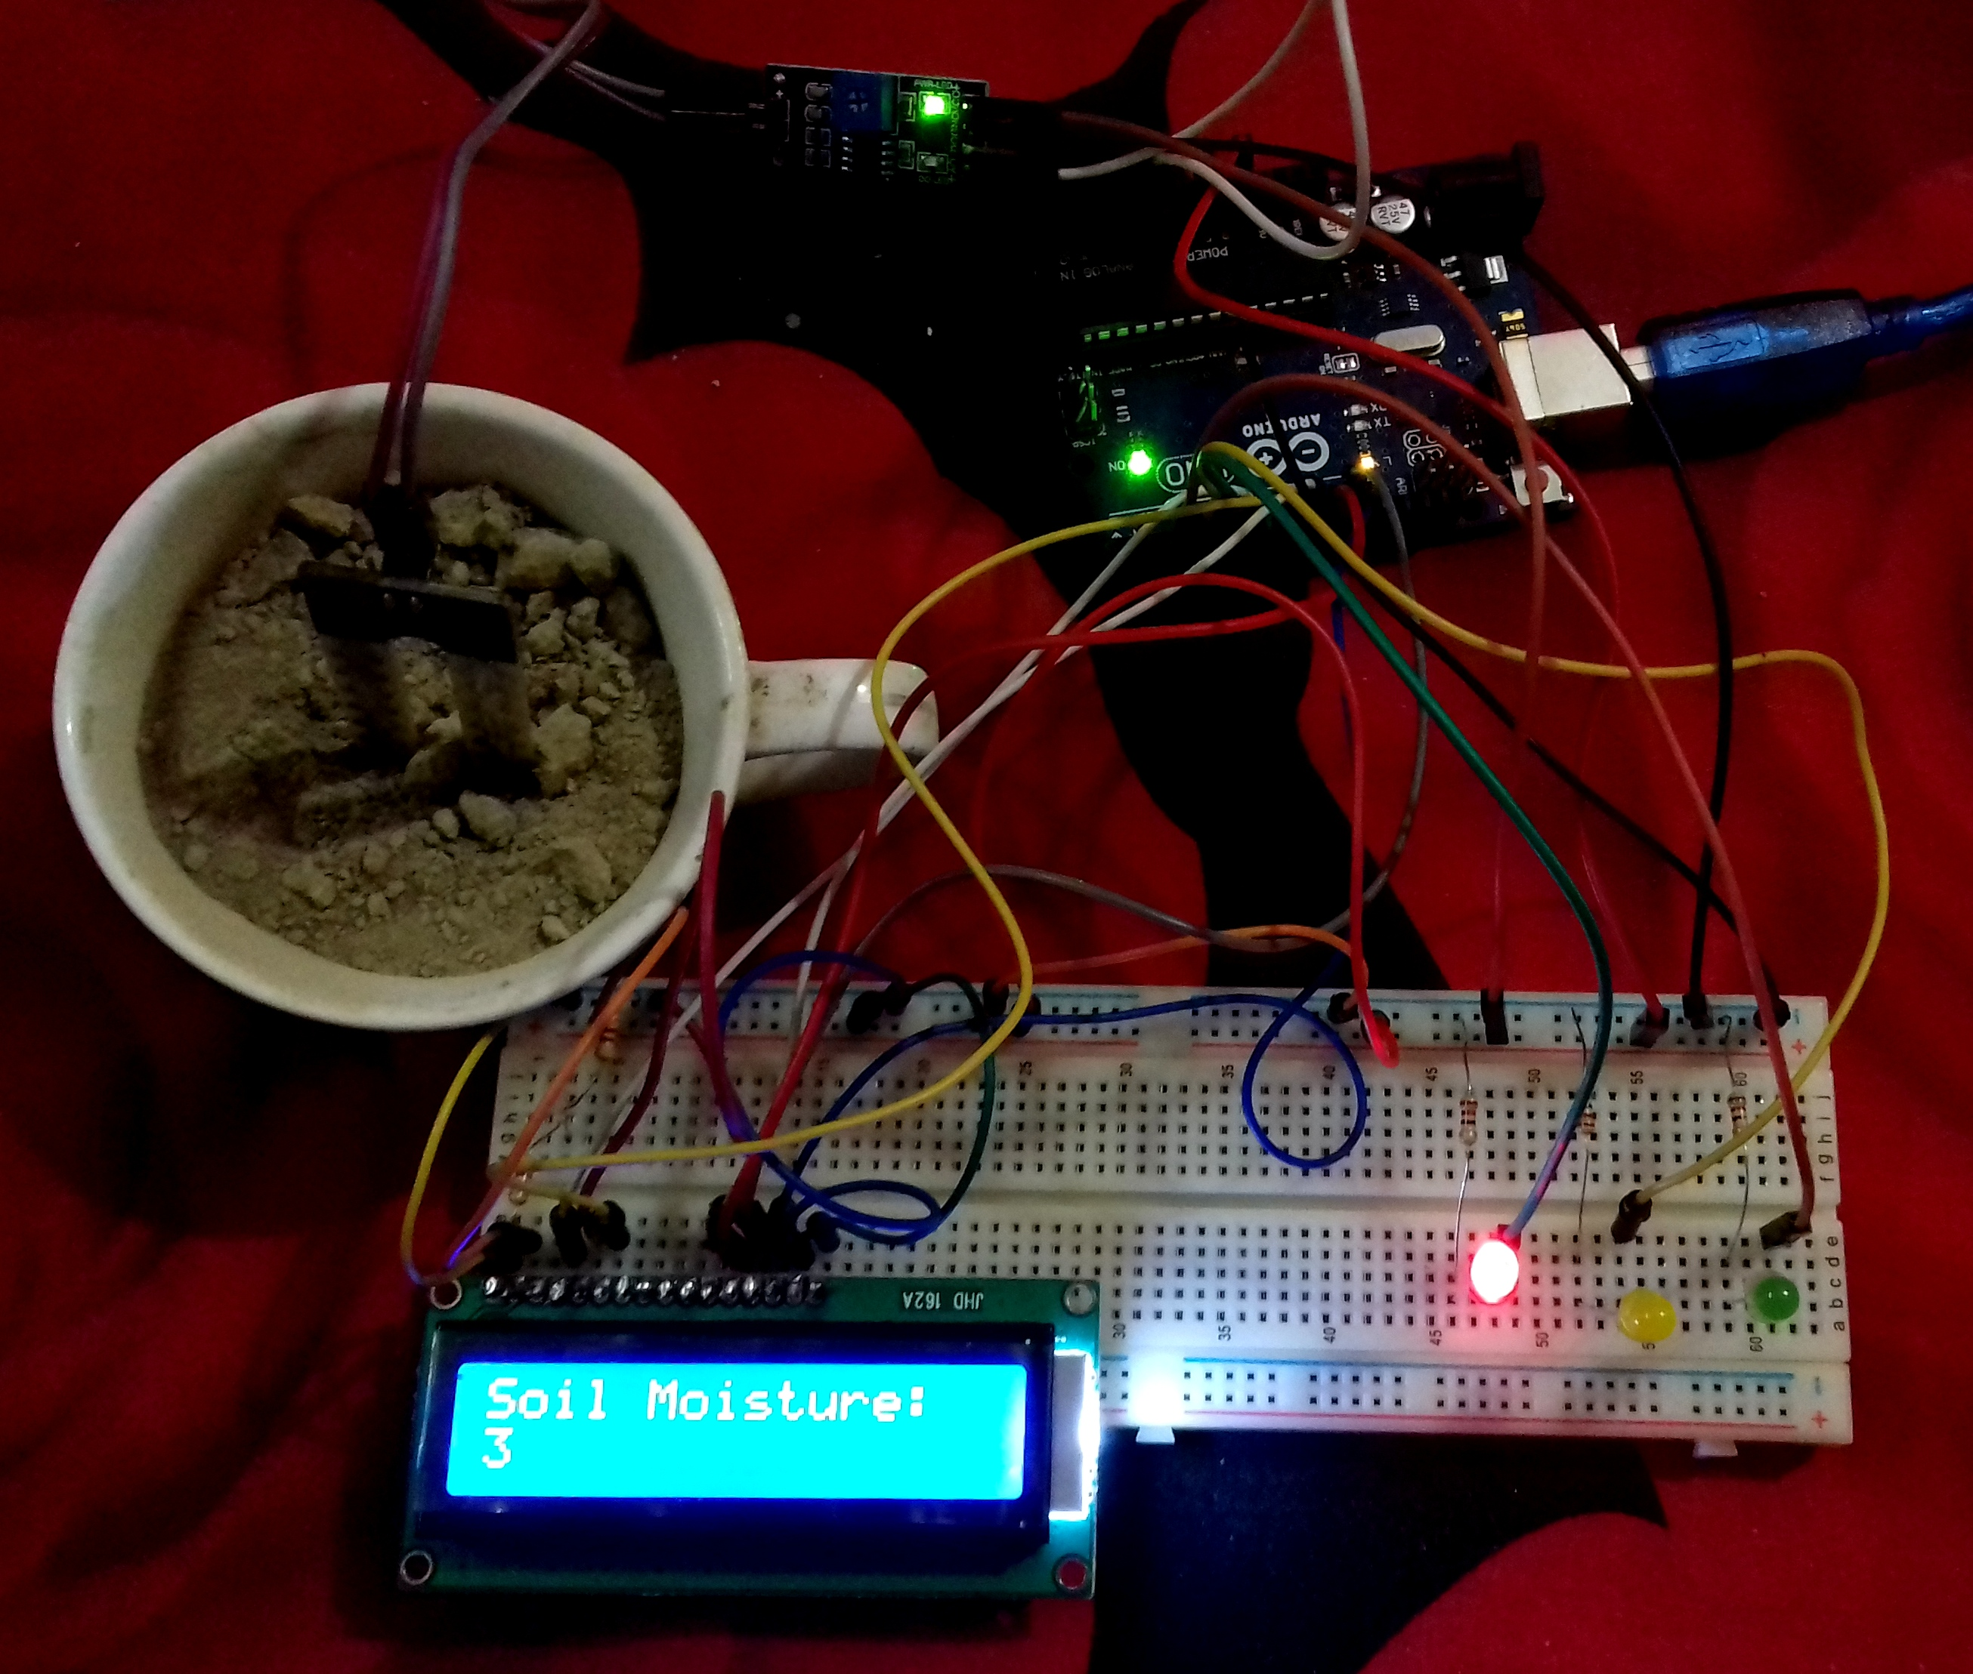
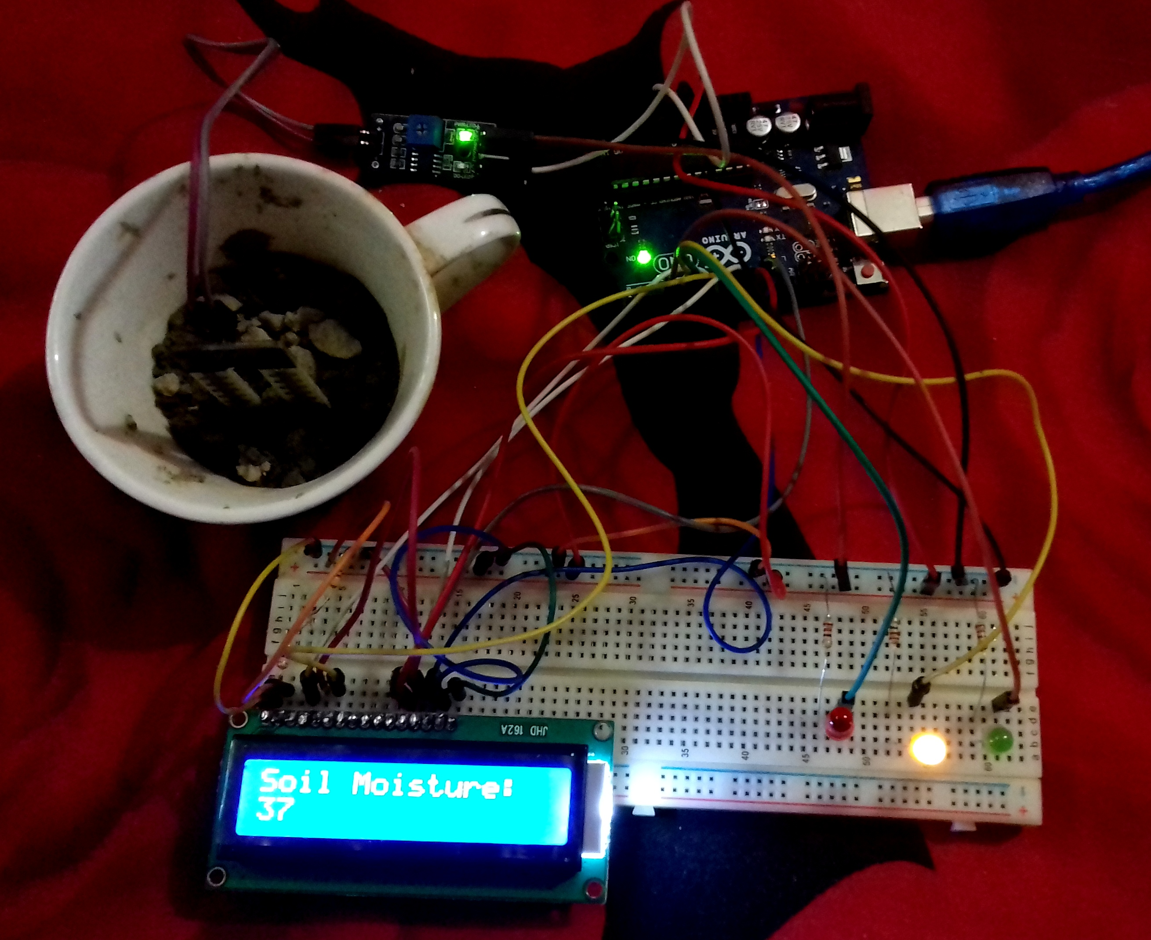
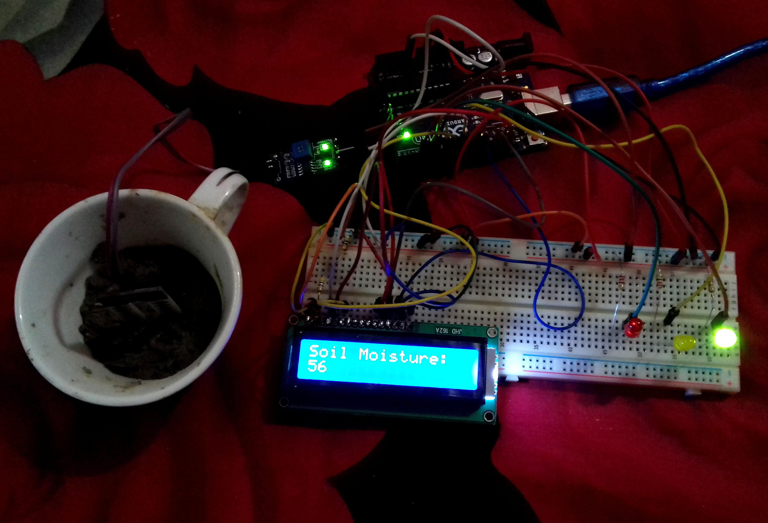
Analysing Final Result

Slide 12
Limitations & Future Modifications
As the Device is not equipped with Wi-Fi module which limit us to send the data to a distant reader.
The device can be made more efficient if it can measure how much water is needed to add in the soil for getting into adequate moisture range.

Slide 13
Thank You

